Slide 1
IGGI Module AI Based Game Design
Diego Perez and Simon Lucas
with Ivan Bravi, Vanessa Volz, Mike Cook and Simon Colton

Slide 2
AI + AI Informed Game Design
How can we design and deploy AI in games
as opponents, collaborators, testers
How can AI be used to make better games?
Set design objectives
Then try to meet them
Measure activity of a range of AI bots
What aspects of bot activity predict human experience?
The course will be taught with a mixture of lectures, labs (including game AI competitions) and group work
Notes:
What does better mean?

Slide 3
What you might do …
Design a simple new game or modify an existing one
Spice it up with some new features
Test and tune them with agent-based AI
OR tune a range of AI agents to enhance a 2-player game with interesting opponents

Slide 4
Main Topics
General and easily applied AI Agent Algorithms via Statistical Forward Planning (SFP)
Rolling Horizon Evolution
Monte Carlo Tree Search
Game Design Spaces
Design, Implementation and Testing
What to optimise
And how to measure it and form Objective Functions
Sample Efficient Noisy Optimisation
Important for Game Tuning
And AI Agent Tuning
We’ll use the N-Tuple Bandit Evolutionary Algorithm (NTBEA)
Mini AI Competition
Notes:
These SFP algorithms are a game changer – they enable general good performance AI across a wide range of games WITHOUT the need for any tuning!

Slide 5
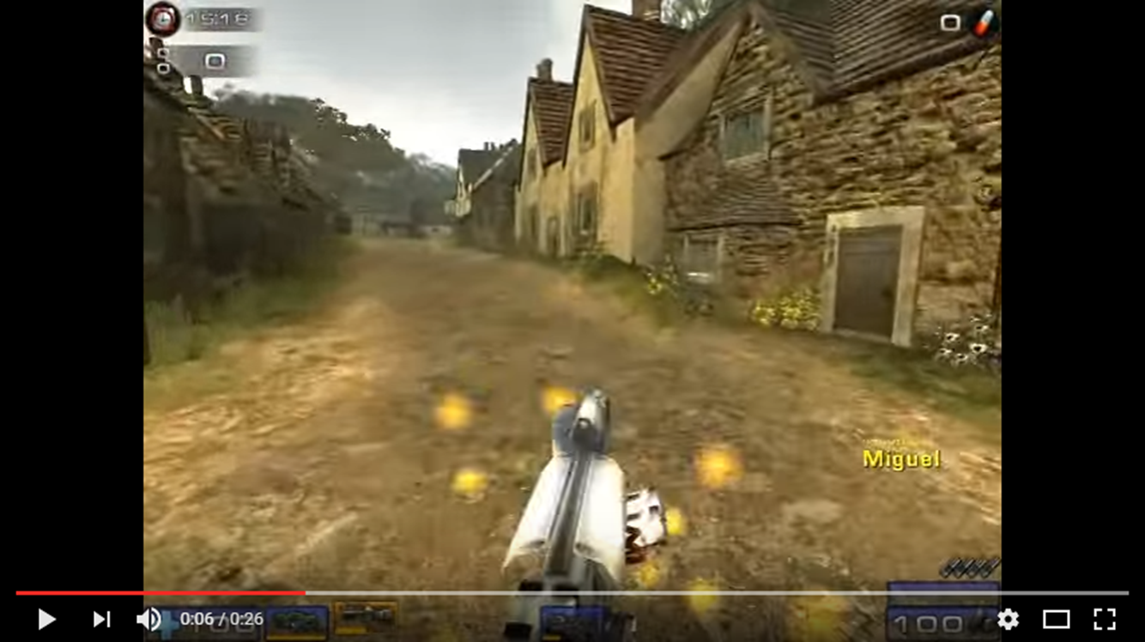
Applications of Adaptive Game AI
Instant high quality opponents and / or collaborators
No programming of the agent needed – just ensure that the game implements a standard interface
Can train them to be more human-like e.g2k Bot Prize (unreal tournament)
Automated play testing of games
Can invent new games easily!
Picking the good ones is the trickier part…
Adaptive AI can help
Measure drama
Measure skill
Can “good” players beat random players
Use league results as evidence of skill depth

Slide 6
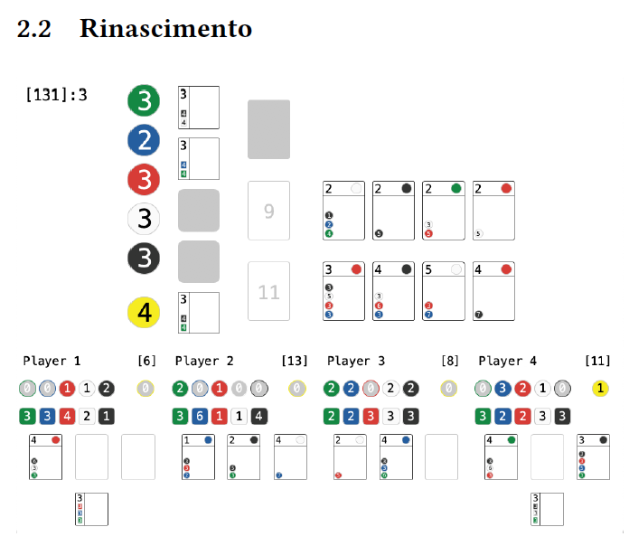
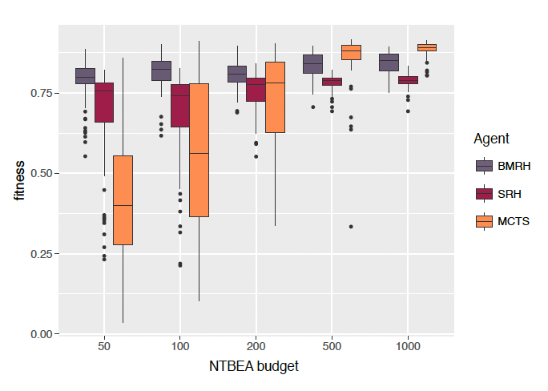
Demonstrator: Ivan Bravi
Notes:
Ivan has used NTBEA to optimise Splendor Agents…

Slide 7
Guest Speakers

Slide 8
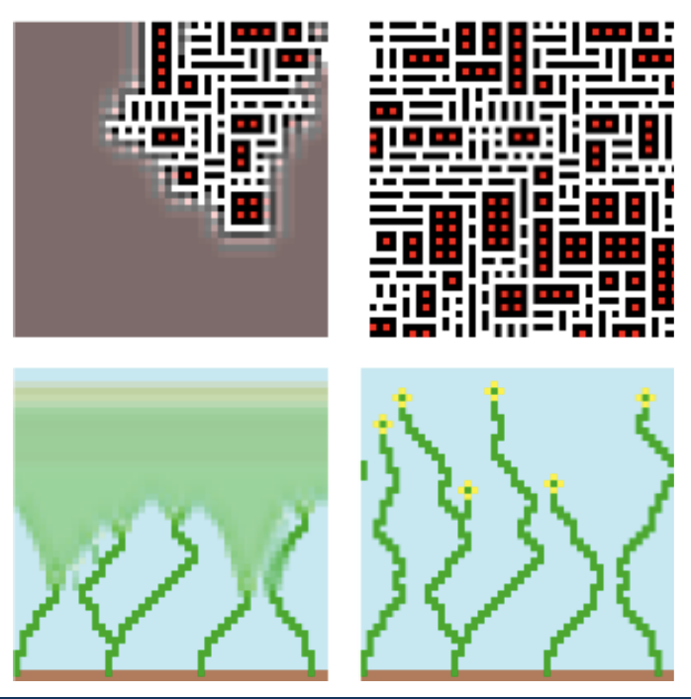
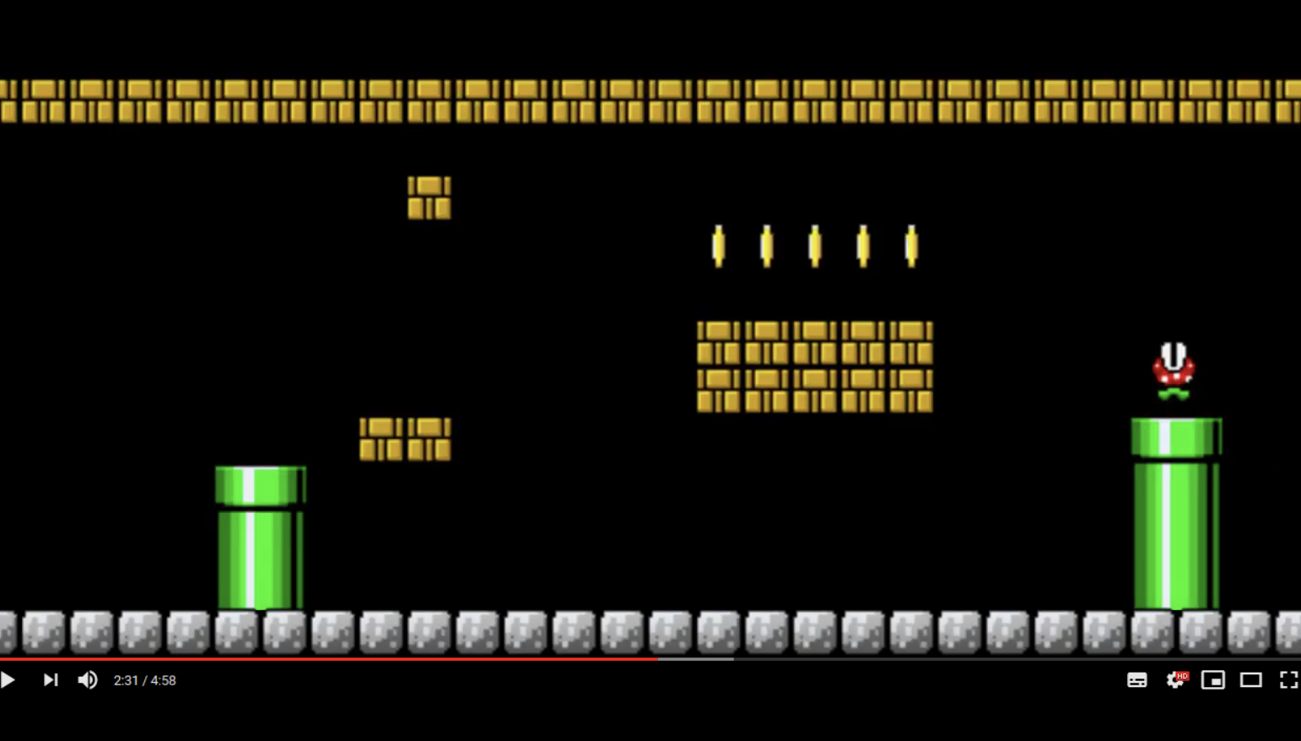
Vanessa Volz: PCG

Slide 9
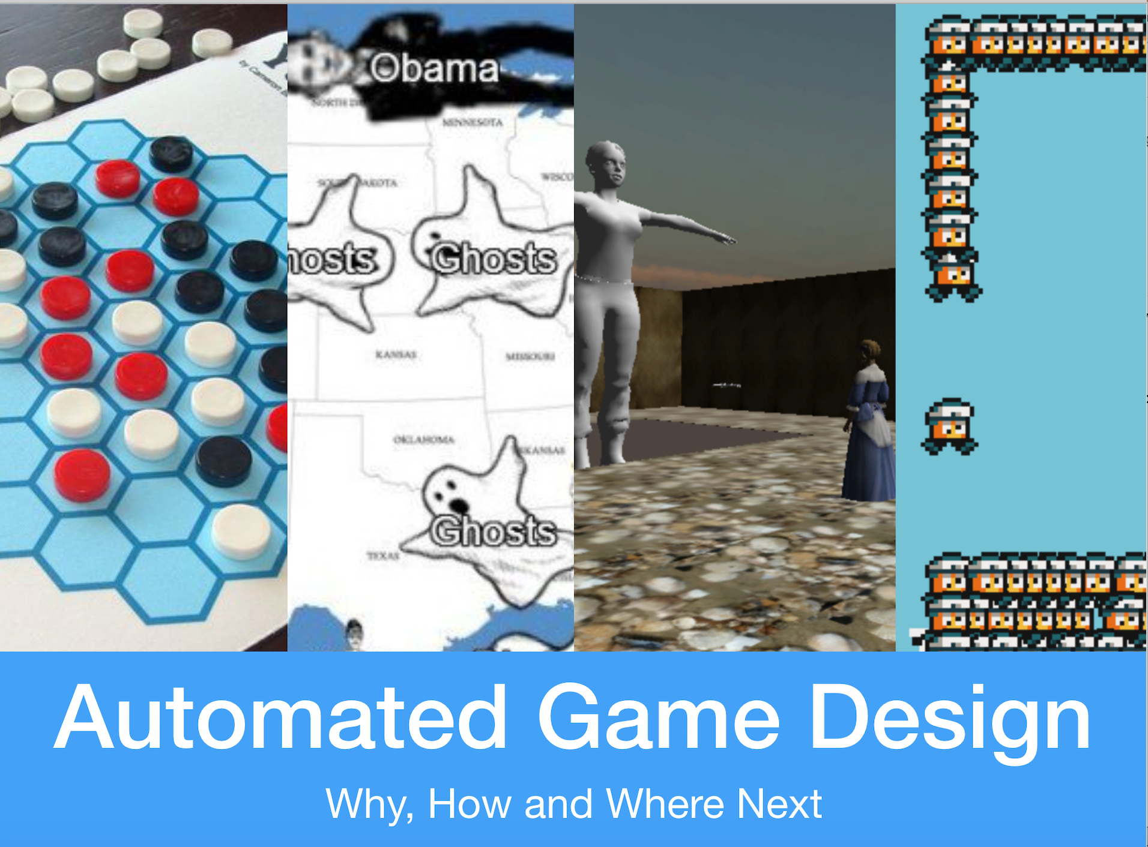
Mike Cook:

Slide 10
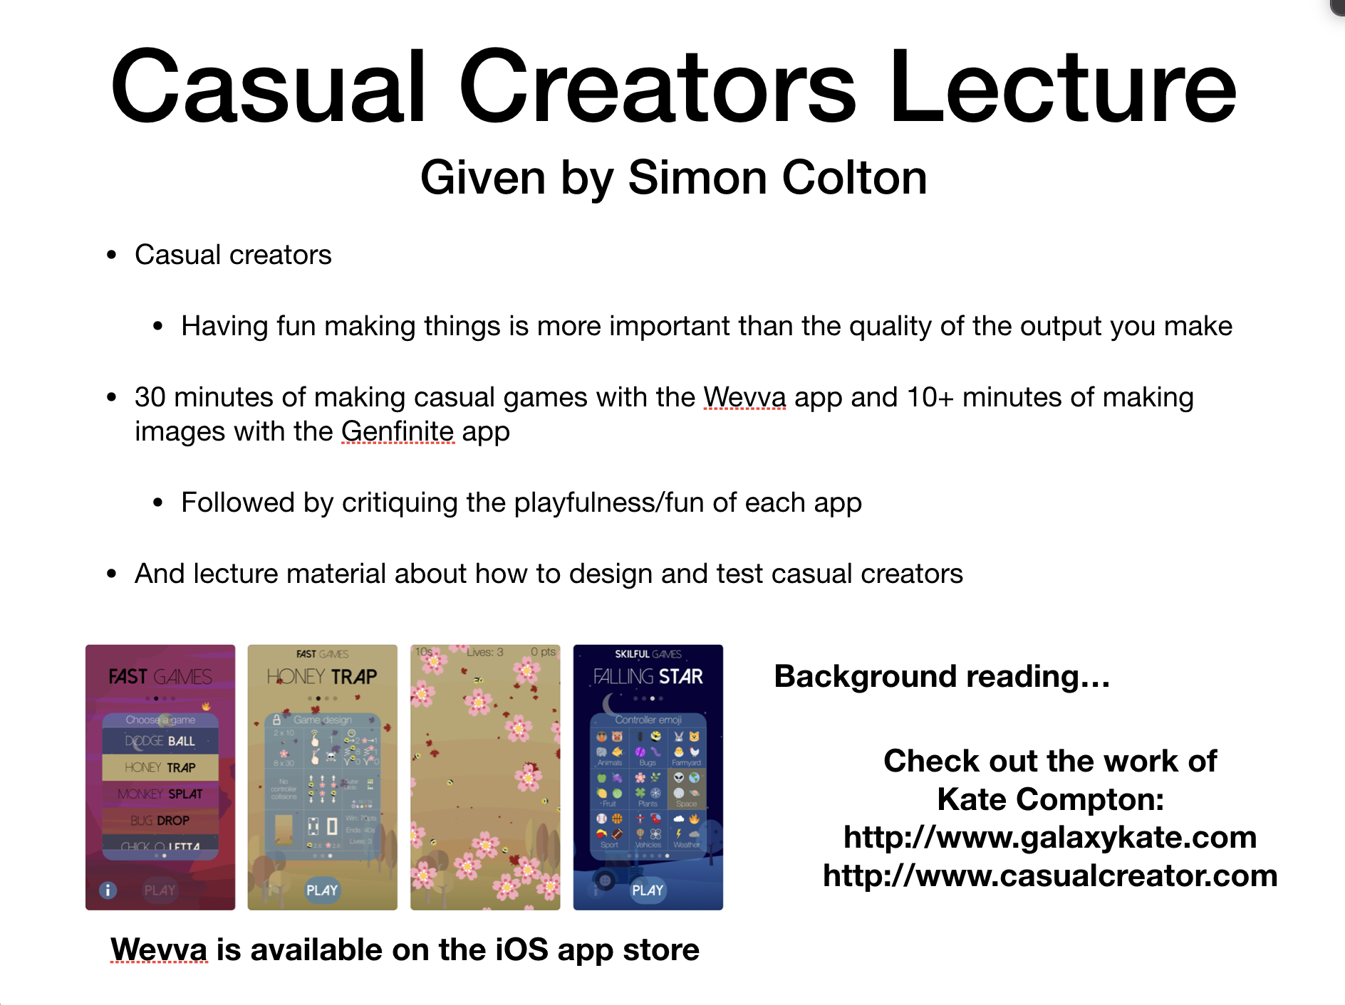
Simon Colton: Casual Creators

Slide 11
Questions?

